Slide 1
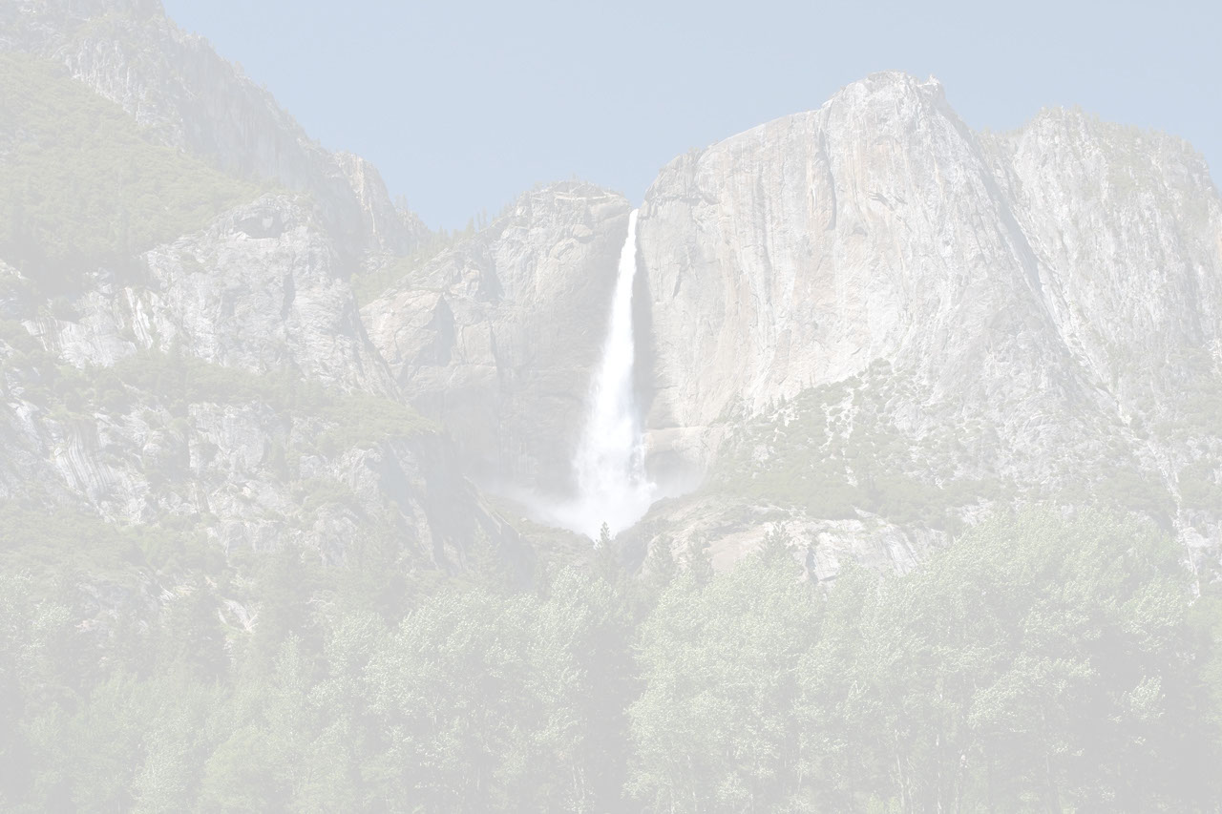
Key Things You Need to Know About RDF
and Why They Are Important
David Booth, Ph.D.
HRG & Rancho BioSciences
david@dbooth.org
Smart Data Conference
18-Aug-2015
Latest version of these slides:
http://dbooth.org/2015/key/

Slide 2
RDF is
fundamentally different
from other data formats – XML, JSON, etc.
This presentation explains why.
But first, some background . . .

Slide 3
Comparing RDF with XML or JSON
WARNING: Improper comparison!
XML, JSON or any other format could be used in special ways to achieve all of RDF's features
  But that isn't how they are normally used
This talk compares RDF with XML and JSON as they are normally used

Slide 4
What is RDF?
"Resource Description Framework"
  But think "Reusable Data Framework"
Language for representing information
International standard by W3C
Mature: 10+ years
Used in many domains, including biomedical and pharma

Slide 5
RDF Assertions (a/k/a "Triples")
PREFIX ex: <http://.../data/>
PREFIX v: <http://.../vocab/>
ex:patient319 v:fullName "John Doe" .
ex:patient319 v:systolicBP ex:obs_001 .
ex:obs_001 v:value 120 .
ex:obs_001 v:units v:mmHg .

Slide 6
RDF Assertions (a/k/a "Triples")
Subject
Predicate
or Property
Object
or Value
PREFIX ex: <http://.../data/>
PREFIX v: <http://.../vocab/>
ex:patient319 v:fullName "John Doe" .
ex:patient319 v:systolicBP ex:obs_001 .
ex:obs_001 v:value 120 .
ex:obs_001 v:units v:mmHg .

Slide 7
RDF Assertions (a/k/a "Triples")
Equivalent English sentence:
Patient319 has full name "John Doe".
PREFIX ex: <http://.../data/>
PREFIX v: <http://.../vocab/>
ex:patient319 v:fullName "John Doe" .
ex:patient319 v:systolicBP ex:obs_001 .
ex:obs_001 v:value 120 .
ex:obs_001 v:units v:mmHg .

Slide 8
RDF Assertions (a/k/a "Triples")
Equivalent English sentence:
Patient319 has a systolic blood
pressure observation obs_001.
PREFIX ex: <http://.../data/>
PREFIX v: <http://.../vocab/>
ex:patient319 v:fullName "John Doe" .
ex:patient319 v:systolicBP ex:obs_001 .
ex:obs_001 v:value 120 .
ex:obs_001 v:units v:mmHg .

Slide 9
RDF Assertions (a/k/a "Triples")
PREFIX ex: <http://.../data/>
PREFIX v: <http://.../vocab/>
ex:patient319 v:fullName "John Doe" .
ex:patient319 v:systolicBP ex:obs_001 .
ex:obs_001 v:value 120 .
ex:obs_001 v:units v:mmHg .
Equivalent English sentence:
Obs_001 has a value of 120.

Slide 10
RDF Assertions (a/k/a "Triples")
PREFIX ex: <http://.../data/>
PREFIX v: <http://.../vocab/>
ex:patient319 v:fullName "John Doe" .
ex:patient319 v:systolicBP ex:obs_001 .
ex:obs_001 v:value 120 .
ex:obs_001 v:units v:mmHg .
Equivalent English sentence:
Obs_001 has units of mmHg.

Slide 11
RDF Assertions (a/k/a "Triples")
PREFIX ex: <http://.../data/>
PREFIX v: <http://.../vocab/>
ex:patient319 v:fullName "John Doe" .
ex:patient319 v:systolicBP ex:obs_001 .
ex:obs_001 v:value 120 .
ex:obs_001 v:units v:mmHg .
Sets of assertions form an RDF graph . . .

Slide 12
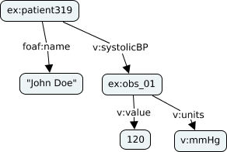
RDF Graph
PREFIX ex: <http://.../data/>
PREFIX v: <http://.../vocab/>
ex:patient319 v:fullName "John Doe" .
ex:patient319 v:systolicBP ex:obs_001 .
ex:obs_001 v:value 120 .
ex:obs_001 v:units v:mmHg .
RDF graph

Slide 13
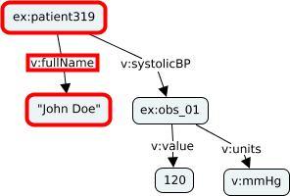
RDF Graph
PREFIX ex: <http://.../data/>
PREFIX v: <http://.../vocab/>
ex:patient319 v:fullName "John Doe" .
ex:patient319 v:systolicBP ex:obs_001 .
ex:obs_001 v:value 120 .
ex:obs_001 v:units v:mmHg .
RDF graph

Slide 14
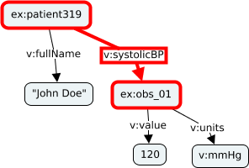
RDF Graph
PREFIX ex: <http://.../data/>
PREFIX v: <http://.../vocab/>
ex:patient319 v:fullName "John Doe" .
ex:patient319 v:systolicBP ex:obs_001 .
ex:obs_001 v:value 120 .
ex:obs_001 v:units v:mmHg .
RDF graph

Slide 15
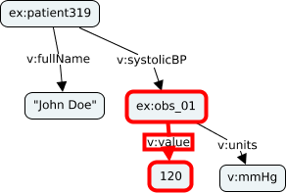
RDF Graph
PREFIX ex: <http://.../data/>
PREFIX v: <http://.../vocab/>
ex:patient319 v:fullName "John Doe" .
ex:patient319 v:systolicBP ex:obs_001 .
ex:obs_001 v:value 120 .
ex:obs_001 v:units v:mmHg .
RDF graph

Slide 16
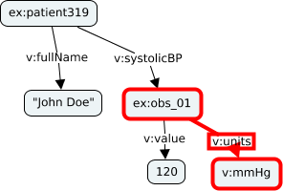
RDF Graph
PREFIX ex: <http://.../data/>
PREFIX v: <http://.../vocab/>
ex:patient319 v:fullName "John Doe" .
ex:patient319 v:systolicBP ex:obs_001 .
ex:obs_001 v:value 120 .
ex:obs_001 v:units v:mmHg .
RDF graph

Slide 17
What is RDF good for?
Large-scale information integration
Semantically connecting diverse data models and vocabularies
Translating between data models and vocabularies
Smarter data use
Let's see why . . .

Slide 18
Key things you need to know about RDF
#5: RDF is self describing
  RDF uses URIs as identifiers
#4: RDF is easy to map from other data representations
  RDF data is made of assertions
#3: RDF captures information – not syntax
  RDF is format independent
#2: Multiple data models and vocabularies can be easily combined and interrelated
  RDF is multi-schema friendly
#1: RDF enables smarter data use and automated data translation
  RDF enables inference

Slide 19
#5: RDF is self describing
Uses URIs as identifiers
http://www.drugbank.ca/drugs/DB00945

Slide 20
#5: RDF is self describing
Uses URIs as identifiers
http://www.drugbank.ca/drugs/DB00945
drugbank:
DB00945
Often abbreviated in RDF:
PREFIX drugbank: <http://www.drugbank.ca/drugs/>
drugbank:DB00945 . . . .

Slide 21

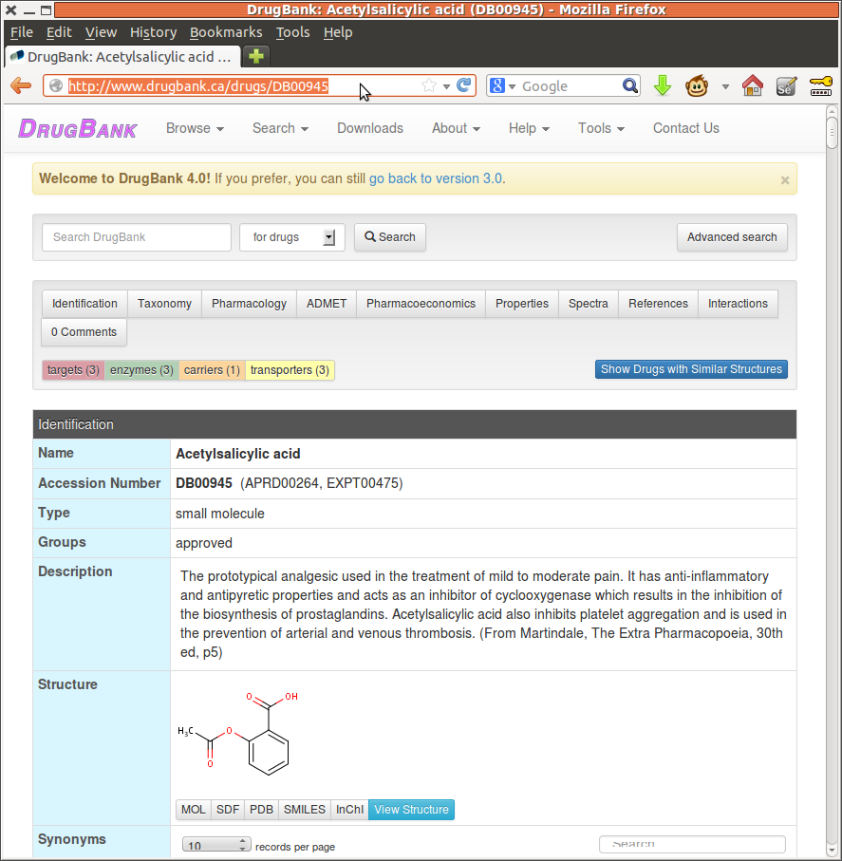
#5: RDF is self describing
Uses URIs as identifiers
http://www.drugbank.ca/drugs/DB00945

Slide 22
Why is this important?
Terms, data models, vocabularies, etc., can be linked to definitions
Definition can be found by any party
  Reduces ambiguity
Aids in bootstrapping new terms toward standardization
Supports standards and innovation

Slide 23
Terms are self describing?
✔
XML:
  Can be just as good as RDF if
  namespaces are properly used
  In practice, namespaces are not always used or clickable to definitions
JSON:
  In theory, could be used like RDF
  In practice, almost never done
½

Slide 24
#4: RDF is easy to map from other data representations
RDF represents information as triples
Triples form a graph

Slide 25

RDF Graph
PREFIX ex: <http://.../data/>
PREFIX v: <http://.../vocab/>
ex:patient319 v:fullName "John Doe" .
ex:patient319 v:systolicBP ex:obs_001 .
ex:obs_001 v:value 120 .
ex:obs_001 v:units v:mmHg .
RDF graph

Slide 26
Why does this matter?
Easy to represent any data model
  Hierarchical, relational, graph, etc.
Easy to map any data format to RDF
  E.g., XML, JSON, CSV, SQL tables, etc.
Great for data integration!

Slide 27
Hierarchical data model in RDF

Slide 28
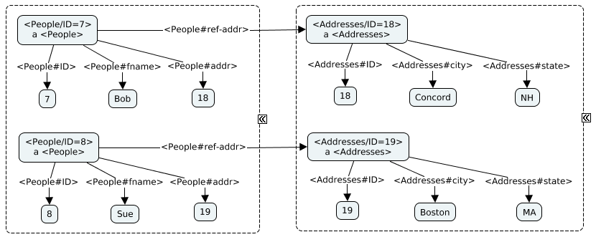
Relational data model in RDF
People
Addresses
ID | fname | addr
7 | Bob | 18
8 | Sue | 19
ID | City | State
18 | Concord | NH
19 | Boston | MA
See W3C Direct Mapping of Relational Data to RDF:
http://www.w3.org/TR/rdb-direct-mapping/

Slide 29
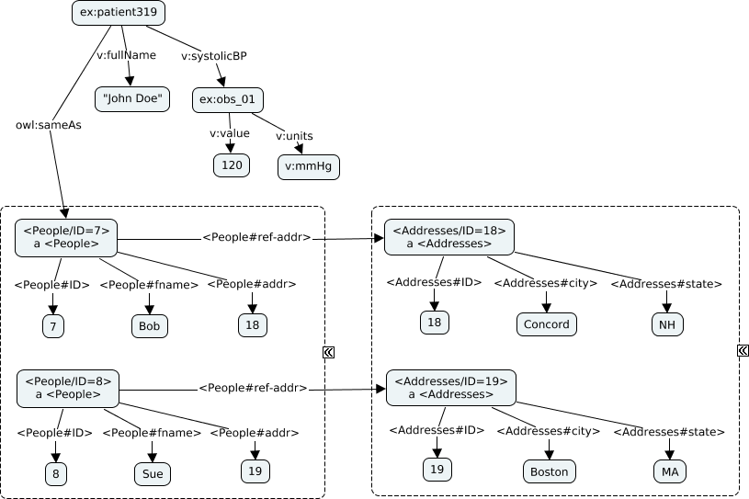
Combined: Hierarchical + Relational

Slide 30
Combined: Hierarchical + Relational
Hierarchical
Portion

Slide 31
Combined: Hierarchical + Relational
Relational
Portion

Slide 32
Easy to map from other formats?
½
XML:
  Graphs are possible but messy
JSON:
  Except cyclic graphs
✔

Slide 33
#3: RDF captures information
– not syntax
RDF is format independent
There are multiple RDF syntaxes: Turtle, N-Triples, JSON-LD, RDF/XML, etc.
The same information can be written in different formats
Any data format can be mapped to RDF

Slide 34
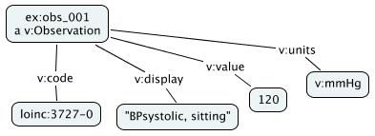
RDF examples
RDF (Turtle)
RDF graph
@prefix ex: <http://example/ex/> .
@prefix loinc: <http://loinc.org/> .
@prefix v: <http://example/v/> .
ex:obs_001 a v:Observation ;
v:code loinc:3727-0 ;
v:display "BPsystolic, sitting" ;
v:value 120 ;
v:units v:mmHg .
RDF (N-Triples)
<http://example/ex/obs_001> <http://www.w3.org/1999/02/22-rdf-syntax-ns#type> <http://example/v/Observation> .
<http://example/ex/obs_001> <http://example/v/code> <http://loinc.org/3727-0> .
<http://example/ex/obs_001> <http://example/v/display> "BPsystolic, sitting" .
<http://example/ex/obs_001> <http://example/v/value> "120"^^<http://www.w3.org/2001/XMLSchema#integer> .
<http://example/ex/obs_001> <http://example/v/units> <http://example/v/mmHg> .
Same information!

Slide 35
RDF examples
RDF (JSON-LD)
RDF graph
{
"@id": "http://example/ex/obs_001",
"@type": "http://example/v/Observation",
"http://example/v/code": {
"@id": "http://loinc.org/3727-0"
},
"http://example/v/display": "BPsystolic, sitting",
"http://example/v/units": {
"@id": "http://example/v/mmHg"
},
"http://example/v/value": 120
}
RDF (RDF/XML)
<?xml version="1.0" encoding="utf-8"?>
<rdf:RDF xmlns:ex="http://example/ex/" xmlns:loinc="http://loinc.org/"
xmlns:rdf="http://www.w3.org/1999/02/22-rdf-syntax-ns#" xmlns:v="http://example/v/">
<rdf:Description rdf:about="http://example/ex/obs_001">
<rdf:type rdf:resource="http://example/v/Observation"/>
</rdf:Description>
<rdf:Description rdf:about="http://example/ex/obs_001">
<v:code rdf:resource="http://loinc.org/3727-0"/>
</rdf:Description>
<rdf:Description rdf:about="http://example/ex/obs_001">
<v:display>BPsystolic, sitting</v:display>
</rdf:Description>
<rdf:Description rdf:about="http://example/ex/obs_001">
<v:value rdf:datatype="http://www.w3.org/2001/XMLSchema#integer">120</v:value>
</rdf:Description>
<rdf:Description rdf:about="http://example/ex/obs_001">
<v:units rdf:resource="http://example/v/mmHg"/>
</rdf:Description>
</rdf:RDF>
Same
info!

Slide 36
Different source formats, same RDF
HL7 v2.x
FHIR
OBX|1|CE|3727-0^BPsystolic,
sitting||120||mmHg|
<Observation
xmlns="http://hl7.org/fhir">
<system value="http://loinc.org"/>
<code value="3727-0"/>
<display value="BPsystolic, sitting"/>
<value value="120"/>
<units value="mmHg"/>
</Observation>
Maps to
Maps to
RDF graph

Slide 37
Why does this matter?
Emphasis is on the meaning (where it should be)
RDF acts as a universal information representation
  Different formats can be exchanged with the same meaning

Slide 38


RDF as a universal information representation
RDF
FHIR
<Observation ...>
<system value="http://loinc.org"/>
<code value="3727-0"/>
...
</Observation>
HL7 v2.x
OBX|1|CE|3727-0^BPsystolic,
sitting||120||mmHg|

Slide 39
Why does this matter?
Helps avoid the bike shed effect in standards,
a/k/a Parkinson's Law of Triviality
  Standards committees often spend hours arguing over syntax and naming -- irrelevant to computable information content

Slide 40
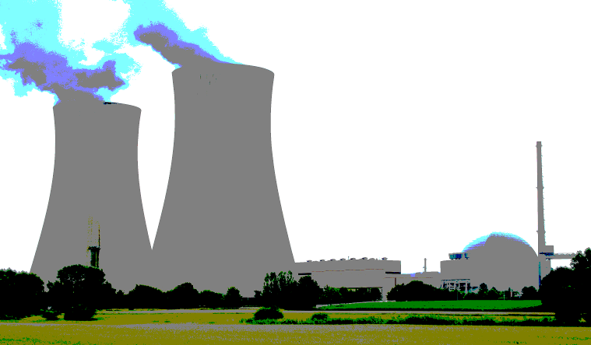
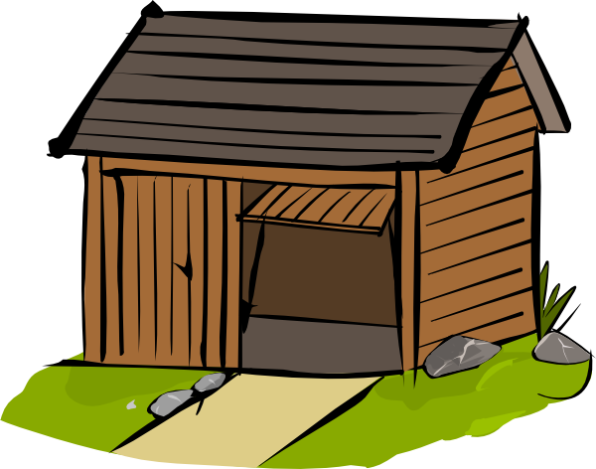
Bike shed effect a/k/a Parkinson's Law of Triviality
Organizations spend disproportionate time
on trivial issues. -- C.N. Parkinson, 1957
1. Nuclear Plant
2. Bike Shed
Cost: $28,000,000
Discussion: 2.5 minutes
Cost: $1,000
Discussion: 45 minutes

Slide 41
Captures meaning, not syntax?
✘
XML:
  Syntax only
JSON:
  Syntax only
½

Slide 42
#2: Multiple data models and vocabularies can be easily combined and interrelated
RDF is multi-schema friendly*
Multiple data models/schemas and vocabularies can peacefully co-exist, semantically connected
*A/k/a schema-promiscuous, schema-flexible, schema-less, etc.

Slide 43
Multi-schema friendly
Blue App has model
Blue Model
Country
Address
FirstName
LastName
Email
City
ZipCode
Notes:
I'm still trying to figure out a good word that conveys the right idea here, because "promiscuous" has some negative connotations. "Henotic" (promoting harmony or peace) is very descriptive, but it is not well enough known.
Other ideas: friendly, henotic, absorbent, thirsty, greedy, eager

Slide 44
Multi-schema friendly
Red App has model
Red Model
HomePhone
Town
ZipPlus4
FullName
Country

Slide 45
Multi-schema friendly
Merge RDF data
Same nodes (URIs) join automatically
Red Model
Blue Model
HomePhone
Town
ZipPlus4
FullName
Country
Country
Address
FirstName
LastName
Email
City
ZipCode

Slide 46
Multi-schema friendly
Add relationships and rules
(Relationships are also RDF)
Red Model
Blue Model
HomePhone
Town
ZipPlus4
FullName
Country
Country
Address
FirstName
LastName
Email
hasFirst
hasLast
sameAs
City
ZipCode
subClassOf

Slide 47
Multi-schema friendly
Later add Green model
(Using Red & Blue models)
Red Model
Green Model
Blue Model
HomePhone
Town
ZipPlus4
FullName
Country
Country
Address
FirstName
LastName
Email
hasFirst
hasLast
sameAs
City
ZipCode
subClassOf
Multiple models peacefully coexist

Slide 48
Multi-schema friendly
Blue app sees Blue model
Green Model
Blue Model
Red Model
Blue Model
HomePhone
Town
ZipPlus4
FullName
Country
Country
Country
Country
Address
Address
FirstName
FirstName
LastName
LastName
Email
Email
ZipCode
City
ZipCode
City

Slide 49
Multi-schema friendly
Red app sees Red model
Red Model
Green Model
Blue Model
Red Model
HomePhone
HomePhone
Town
Town
ZipPlus4
ZipPlus4
FullName
FullName
Country
Country
Country
Address
FirstName
LastName
Email
City
ZipCode

Slide 50
Multi-schema friendly
Green app sees Green model
Green Model
Red Model
Green Model
Blue Model
HomePhone
HomePhone
Town
Town
ZipPlus4
ZipPlus4
FullName
Country
Country
Country
Country
Address
FirstName
FirstName
LastName
LastName
Email
Email
City
ZipCode

Slide 51
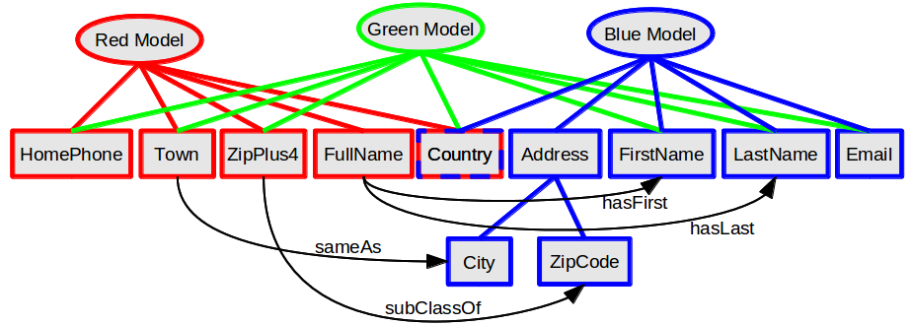
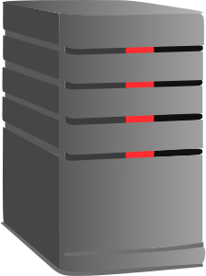
Different views for different systems

Slide 52
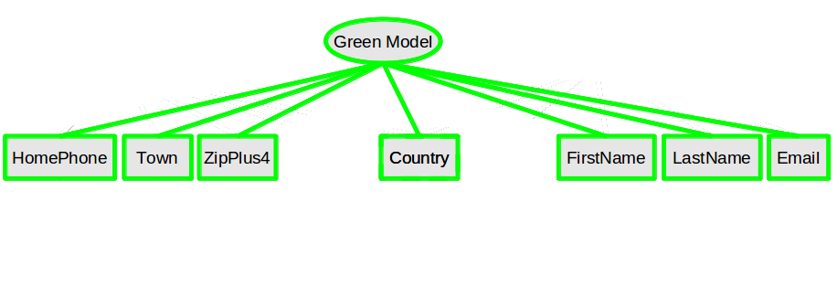
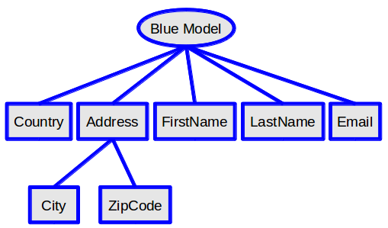
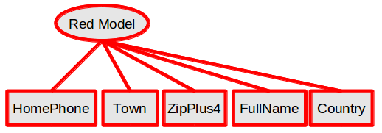
Different views for different systems

Slide 53
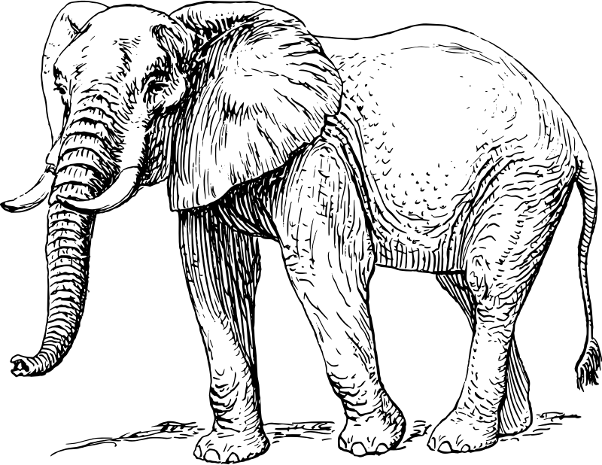
Different views for different systems

Slide 54
Why is this important?
Multiple data models and vocabularies can be:
  added dynamically
  used together harmoniously
This is critical in domains that involve many or changing data models/vocabularies
Even standards change!
  Standards are revised or they become obsolete

Slide 55
Easy to combine and relate data?
✘
XML:
  Schemas compete to be "on top"
  Meaningful merge requires new schema and manual mapping
JSON:
  A little easier than with XML
  But meaningful merge still requires new model and manual mapping
✘

Slide 56
#1: RDF enables smarter data use and automated data translation
RDF enables inference
Inference derives new assertions from old
  "Entailments"
Query for v:HeartValve surgeries can find v:MitralValve surgeries

Slide 57

Inference example
If you know:
?x a v:MitralValve .
v:MitralValve rdfs:subClassOf v:HeartValve .

Slide 58

Inference example
Infer
If you know:
?x a v:MitralValve .
v:MitralValve rdfs:subClassOf v:HeartValve .
You can infer:
?x a v:HeartValve .

Slide 59
Inference example: sameAs
Red Model
Green Model
Blue Model
HomePhone
Town
ZipPlus4
FullName
Country
Address
FirstName
LastName
Email
hasFirst
hasLast
sameAs
City
ZipCode
subClassOf
If you know: Town
You can infer: City (or vice versa)

Slide 60
Inference example: composition
Red Model
Green Model
Blue Model
HomePhone
Town
ZipPlus4
FullName
Country
Address
FirstName
LastName
Email
hasFirst
hasLast
sameAs
City
ZipCode
subClassOf
If you know: FirstName + LastName
You can infer: FullName
  But not necessarily vice versa

Slide 61
Why is this important?
Smarter data use
  Query for v:HeartValve surgeries can find v:MitralValve surgeries

Slide 62
Facilitates smarter queries?
✘
XML:
  No inference
JSON:
  No inference
✘

Slide 63
Why is this important?
Data can be automatically translated between different data models and vocabularies
  E.g., db:DB00945 => v:aspirin
  Red Model data + Blue Model data => Green Model data
Very helpful for data integration!

Slide 64
Inference example: composition
Red Model
Green Model
Blue Model
HomePhone
Town
ZipPlus4
FullName
Country
Address
FirstName
LastName
Email
hasFirst
hasLast
sameAs
City
ZipCode
subClassOf
If you know: FirstName + LastName
You can infer: FullName
  But not necessarily vice versa

Slide 65
Inference example: data translation
Red Model
Green Model
Blue Model
HomePhone
Town
ZipPlus4
FullName
Country
Country
Address
FirstName
LastName
Email
City
ZipCode
If you know: Red Model data + Blue Model data
You can infer: Green Model data

Slide 66
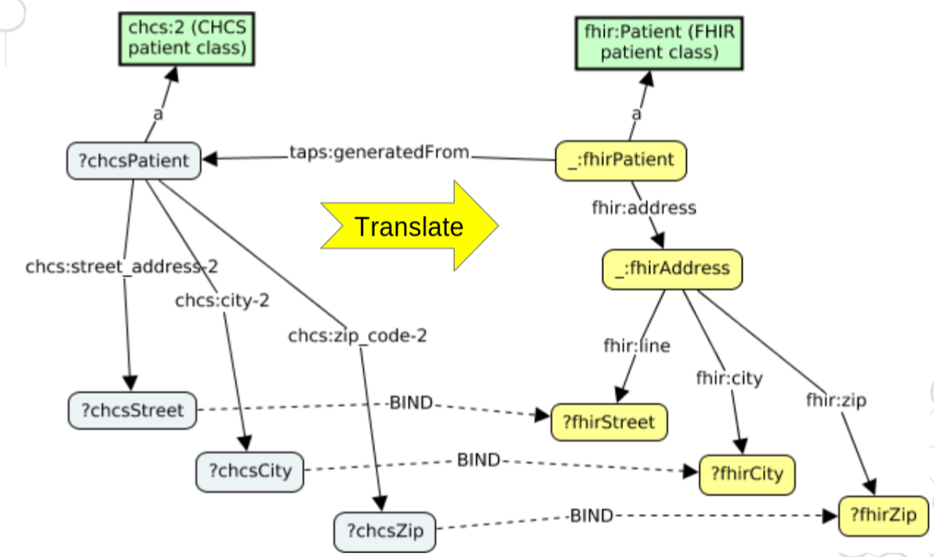
Translation as inference

Slide 67
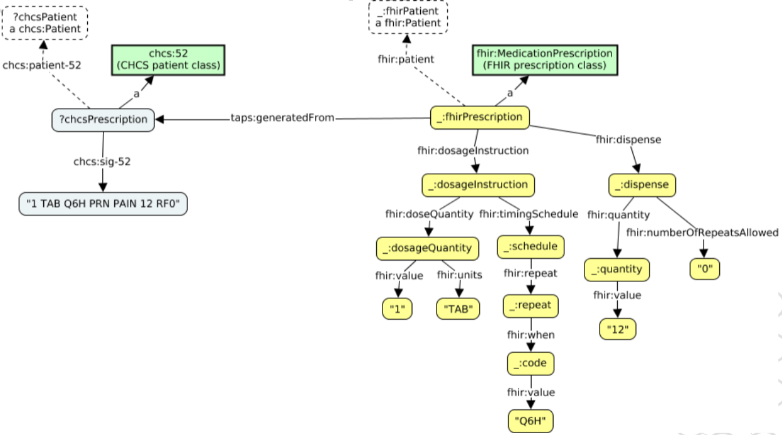
Translation as inference
Translate

Slide 68
Facilitates data translations?
½
XML:
  Not by inference, but tools are available
JSON:
  Not by inference, but tools are available
½

Slide 69
Key things you need to know about RDF
#5: RDF is self describing
  RDF uses URIs as identifiers
#4: RDF is easy to map from other data representations
  RDF data is made of assertions
#3: RDF captures information – not syntax
  RDF is format independent
#2: Multiple data models and vocabularies can be easily combined and interrelated
  RDF is multi-schema friendly
#1: RDF enables smarter queries and automated data translation
  RDF enables inference

Slide 70
Weaknesses of RDF
No silver
bullets!
RDF tools are less mature;
expertise is less widespread
RDF has some annoyances:
  "Blank nodes" have subtleties that add complication (Best to limit their use)
  URI allocation – can be a hassle
Weaknesses should be understood, but are not show stoppers

Slide 71
Conclusions
RDF provides key benefits that distinguish it from other frequently used information representations
RDF is best for problems that involve:
  Large-scale information integration
  Semantically connecting diverse vocabularies and data models
  Changing vocabularies and data models
  Inference and data translation

Slide 72
Questions?

Slide 73
BACKUP SLIDES

Slide 74
Key things you need to know about RDF
#5: RDF is self describing
  RDF uses URIs as identifiers
#4: RDF is easy to map from other data representations
  RDF data is made of assertions
#3: RDF captures information – not syntax
  RDF is format independent
#2: Multiple data models and vocabularies can be easily combined and interrelated
  RDF is multi-schema friendly
#1: RDF enables smarter queries and automated data translation
  RDF enables inference

Slide 75
If time permits . . .
Ivan Herman's Semantic Web tutorial:
http://www.w3.org/People/Ivan/CorePresentations/SWTutorial/Slides.pdf

