Slide 1

Comparing
the Yosemite Project and ONC Roadmaps
for Healthcare Information Interoperability
David Booth, PhD
Yosemite Project Steering Committee
Rancho BioSciences, LLC
Hawaii Resource Group, LLC
These slides: http://dbooth.org/2015/onc/
http://YosemiteProject.org/

Slide 2
Outline
Yosemite Project roadmap
ONC roadmap
Comparison
Q&A

Slide 3
Imagine a world

Slide 4
Imagine a world
in which all healthcare systems
speak the same language
with the same meanings
covering all healthcare.

Slide 5
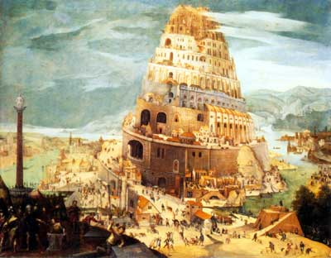
Healthcare today
Tower of Babel, Abel Grimmer (1570-1619)

Slide 6
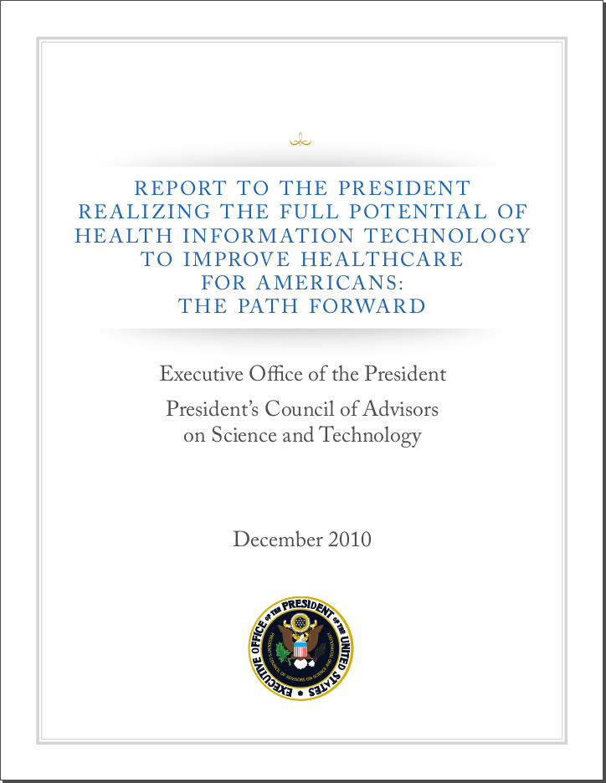

Slide 7
"PCAST has also concluded that to achieve these objectives it is crucial that the Federal Government facilitate the nationwide adoption of a
universal exchange language
for healthcare information"

Slide 8
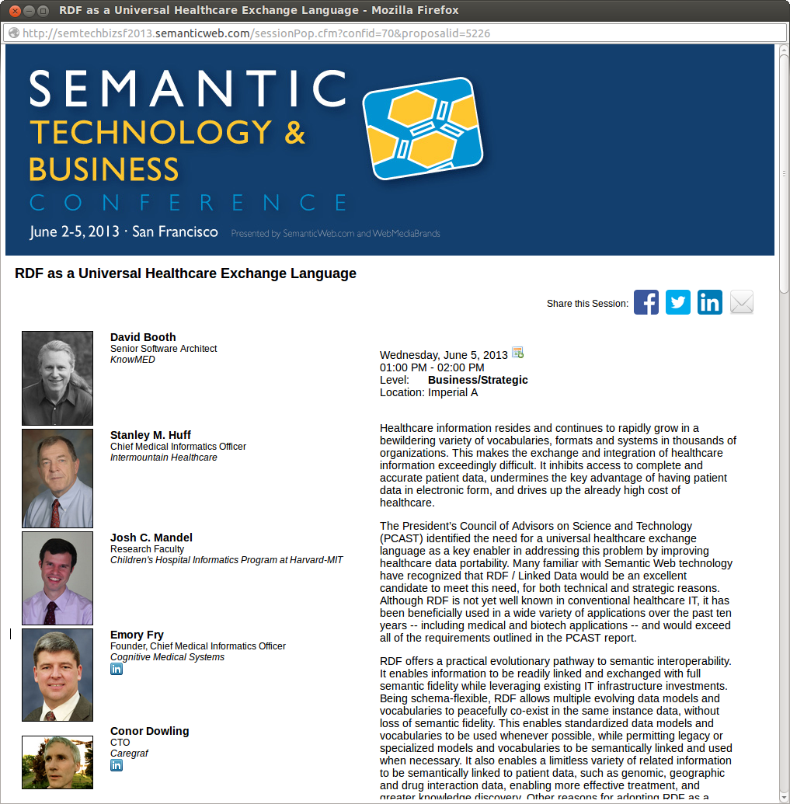
2013 Workshop on "RDF as a Universal Healthcare Exchange Language"
32 participants
Ended up creating the Yosemite Manifesto . . .

Slide 9

Yosemite Manifesto on RDF as a Universal Healthcare Exchange Language
1. RDF is the best available candidate for a universal healthcare exchange language.
2. Electronic healthcare information should be exchanged in a format that either: (a) is an RDF format directly; or (b) has a standard mapping to RDF.
3. Existing standard healthcare vocabularies, data models and exchange languages should be leveraged by defining standard mappings to RDF, and any new standards should have RDF representations.
4. Government agencies should mandate or incentivize the use of RDF as a universal healthcare exchange language.
5. Exchanged healthcare information should be self-describing, using Linked Data principles, so that each concept URI is de-referenceable to its free and open definition.

Slide 10
Yosemite Manifesto on RDF as a Universal Healthcare Exchange Language
1. RDF is the best available candidate for a universal healthcare exchange language.
2. Electronic healthcare information should be exchanged in a format that either: (a) is an RDF format directly; or (b) has a standard mapping to RDF.
3. Existing standard healthcare vocabularies, data models and exchange languages should be leveraged by defining standard mappings to RDF, and any new standards should have RDF representations.
4. Government agencies should mandate or incentivize the use of RDF as a universal healthcare exchange language.
5. Exchanged healthcare information should be self-describing, using Linked Data principles, so that each concept URI is de-referenceable to its free and open definition.
"1. RDF is the
best available candidate
for a universal healthcare
exchange language."

Slide 11
Supporters
1. David Booth, Ph.D., KnowMED, Inc.
2. Charlie Mead, M.D., MSc., Octo Consulting Group
3. Tracy Allison Altman, Ph.D., PepperSlice
4. Michel Dumontier, Associate Professor of
Bioinformatics, Carleton University
5. Rafael Richards MD MS, Johns Hopkins School of Medicine
6. Stanley M. Huff, MD, CMIO Intermountain Healthcare
7. Olivier Curé, PhD,UPEM France
8. Emory Fry, MD, Cognitive Medical Systems
9. Karl Seiler, CEO and founder NUMO Health, a Modus Operandi, Inc. Business
10. Erick Von Schweber, Executive Co-chair SURVEYOR
health *Endorses RDF as a universal exchange "framework"
11. Tom Munnecke, Independent Consultant
12. Thomas J. Kelly, PMP, Cognizant Technology Solutions
13. Dean Allemang, PhD, Working Ontologist LLC
14. Erich A, Gombocz, CSO, IO Informatics, Inc.
15. Blair Myers, Sr. Enterprise Information Architect, STA Group, LLC
16. Hans Constandt, CEO ONTOFORCE, Gent (Belgium)
17. Dave McComb,, Semantic Arts
18. Manuel Wahle, Dipl.-Inform, MS, The University of Texas Health Science Center at Houston
19. Michael Erdmann, PhD, DIQA Gmbh (Germany)
20. Kerstin Forsberg, Principal Informatics Scientist, AstraZeneca
21. Niklas Lindström, senior developer, National Library of Sweden
22. Mark Montgomery, Founder & CEO, Kyield
23. Karl Reti, CEO, Crosslink Software
24. David L. Woolfenden President, eVectis Technologies LLC
25. Matthew Vagnoni, MS, CTO KnowMED.com
26. Chrisotpher Regan
27. Doug Burke, President, Cognitive Medical Systems
28. Jerry Scott, Emcee Partners LLC
29. Rick Pope, Cognitive Medical Systems
30. Charles B. Owen, MD, CMIO, Afoundria
31. Conor Dowling, CTO, Caregraf
32. James McCusker, Yale University
33. Cartik Kothari, PhD, CEO, Perfect Informatics, INDIA
34. Carl Mattocks, Founder, Wellness Intelligence Institute
35. Lee Feigenbaum, VP and Founder, Cambridge Semantics
36. Jamie Ferguson, VP Health IT Policy, Kaiser Permanente.
37. Christian Seppa, Senior Developer, Squishymedia Inc.
38. Dr. Matthias Samwald, Medical University of Vienna
39. Michael Uschold, PhD, Senior Ontology Consultant, Semantic Arts, USA
40. Jon McBride, BACS, MBA, CIO
41. Kathrin Dentler, PhD student, VU University Amsterdam & University of Amsterdam
42. Claude Nanjo, MA MPH, Zynx Health Inc
43. Murray Bent, e-researcher
44. Pedro Lopes, PhD, University of Aveiro
45. Sibi Jacob, Senior Information Analyst, Ramsay Healthcare
46. Carlton Northern, Senior Software Engineer, The MITRE Corporation
47. Michael Denny, PhD, ontology consultant
48. Robert Stanley, CEO, IO Informatics
49. Renato Iannella, PhD, Semantic Identity
50. Janice Kite MBA, MD, A.I.M. Consulting Ltd, UK
51. Jeff Altman, co-Founder, Ugly Research
52. Stephane Fellah,CTO, smartRealm LLC
53. Frank van Harmelen, Prof., VU University Amsterdam
54. Tim Finin, Professor, University of Maryland, Baltimore County
55. François Scharffe, Maître de conférences, Université Montpellier 2
56. Varish Mulwad, PhD candidate, Computer Science, UMBC
57. Deborah M Cooper, Principal, Deborah M Cooper Consulting LLC
58. Joanne S. Luciano, BS MS PhD, Research Associate Professor, Rensselaer Polytechnic Institute, President, Predictive Medicine, Inc.
59. M. Scott Marshall, Ph.D., MAASTRO Clinic, Maastricht, The Netherlands
60. Kalina Bontcheva, Ph.D., University of Sheffield
61. Alan Ruttenberg, Director of Data Warehouse at Institute for Health Informatics, University at Buffalo
62. Dan Brickley, Google
63. Krishna Kumar Kookal, MS, KnowMED Incorporated.
64. Sergey Krikov MS, University of Utah
65. Shelly Kulesza, Project Manager, KnowMED
66. Safa F. Amini, MD, MS, KnowMED Inc.
67. Roy Hogsed, healthcare software
68. Mary Dee Harris, Ph.D., independent consultant
69. David Corsar, PhD, University of Aberdeen, UK
70. Christophe Lambert, PhD, Golden Helix Inc.
71. Javier Fernández Iglesias, Independent Consultant, Spain
72. Paolo Ciccarese, MS PhD, Harvard Medical School
73. François Belleau, Bio2RDF architect
74. Michael Riben, MD MD Anderson Cancer Center
75. Mihai, epek ltd
76. Foster Carr MD, Telemedical.com
77. Binyam Tilahun, MPH,Msc
78. Silviu Braga, MD, IT Project Manager, Scientific Society of General Medicine , Belgium
79. Markus Schneider, Healthcare Data Analyst
80. Ted Slater, CTO, OpenBEL Consortium
81. Laercio Simoes, CEO, HPC Brasil
82. Andrea Splendiani, director, intelliLeaf
83. RJ Herrick, Dir IS, The Connection
84. Eriam Schaffter, Switzerland, independant consultant
85. Erich Bremer, M.Sc., Stony Brook University
86. Alan T. Kaell MD FACP FACR FAAP (1992-2009)
87. Bellraj Eapen, McMaster University
88. David Metcalf, Metcalf Computing
89. Joachim Baran, PhD, Stanford University
90. Marc Twagirumukiza, MD, PhD, Agfa Healthcare N.V
91. Stuart Turner, DVM, MS, Leafpath Informatics
92. Hong Sun, PhD, Agfa Healthcare
93. Achille Zappa, Ph.D., INSIGHT @ NUI Galway - The Centre for Data Analytics
94. Yoshimasa Kawazoe, MD, Ph.D
95. Barry Robson, Original Architect of Q-UEL
96. Graham Hughes, MD, SAS Institute
97. Sivaram Arabandi, MD, MS, ONTOPRO
98. Suresh Batta, MS, Mckesson
99. Salvatore Mungal, Bioinformaticist, Duke University
100. Benedikt Kämpgen, Research Associate, Karlsruhe Institute of Technology, Germany
101. Brian Moon, CTO, Perigean Technologies LLC
102. Andre Dekker, PhD, MAASTRO Clinic
103. Sébastien Letélié, PhD, Health Entrepreneur & Developer
104. Marcello Bax, PhD, Federal University of Minas Gerais - Brasil
105. Natalia Díaz Rodríguez, M. Sc., Philips Research
106. K.D. Pool, MD, COO OZ Systems
100+ signatures at http://YosemiteManifesto.org/
Led to Yosemite Project in 2014

Slide 12
The Yosemite Project

Slide 13
MISSION:
Semantic interoperability
of
all structured healthcare information

Slide 14
STRATEGY:
RDF as a
universal information representation

Slide 15

What is RDF?
W3C standard
Captures information content
independent of data format

Slide 16
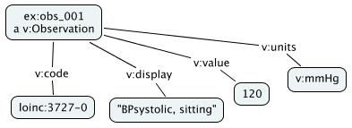
Different source formats, same RDF
HL7 v2.x
FHIR
OBX|1|CE|3727-0^BPsystolic,
sitting||120||mmHg|
<Observation
xmlns="http://hl7.org/fhir">
<system value="http://loinc.org"/>
<code value="3727-0"/>
<display value="BPsystolic, sitting"/>
<value value="120"/>
<units value="mmHg"/>
</Observation>
Maps to
Maps to
RDF information content

Slide 17


RDF as a universal information representation
RDF
FHIR
<Observation ...>
<system value="http://loinc.org"/>
<code value="3727-0"/>
...
</Observation>
HL7 v2.x
OBX|1|CE|3727-0^BPsystolic,
sitting||120||mmHg|

Slide 18
Universal information representation
Q: What does this mean?
A: Determine its RDF information content
Instance data
RDF
<Observation
xmlns="http://hl7.org/fhir">
<system value="http://loinc.org"/>
<code value="3727-0"/>
<display value="BPsystolic, sitting"/>
<value value="120"/>
<units value="mmHg"/>
</Observation>

Slide 19
Multi-schema friendly
Green Model
Blue Model
Red Model
Blue Model
HomePhone
Town
ZipPlus4
FullName
Country
Country
Country
Country
Address
Address
FirstName
FirstName
LastName
LastName
Email
Email
ZipCode
City
ZipCode
City

Slide 20
Multi-schema friendly
Red Model
Green Model
Blue Model
Red Model
HomePhone
HomePhone
Town
Town
ZipPlus4
ZipPlus4
FullName
FullName
Country
Country
Country
Address
FirstName
LastName
Email
City
ZipCode

Slide 21
Multi-schema friendly
Green Model
Red Model
Green Model
Blue Model
HomePhone
HomePhone
Town
Town
ZipPlus4
ZipPlus4
FullName
Country
Country
Country
Country
Address
FirstName
FirstName
LastName
LastName
Email
Email
City
ZipCode

Slide 22
Multi-schema friendly
Red Model
Green Model
Blue Model
HomePhone
Town
ZipPlus4
FullName
Country
Country
Address
FirstName
LastName
Email
hasFirst
hasLast
sameAs
City
ZipCode
subClassOf

Slide 23
Supports inference
Red Model
Green Model
Blue Model
HomePhone
Town
ZipPlus4
FullName
Country
Address
FirstName
LastName
Email
hasFirst
hasLast
sameAs
City
ZipCode
subClassOf

Slide 24
Supports inference
Red Model
Green Model
Blue Model
HomePhone
Town
ZipPlus4
FullName
Country
Address
FirstName
LastName
Email
hasFirst
hasLast
sameAs
City
ZipCode
subClassOf

Slide 25
Semantic interoperability:
The ability of computer systems
to exchange data
with unambiguous, shared meaning.
– Wikipedia

Slide 26
Two ways to achieve interoperability
Standards:
  Make everyone speak the same language
  I.e., same data models and vocabularies
Translations:
  Translate between languages
  I.e., translate between data models and vocabularies

Slide 27
Obviously we prefer
standards.
But . . . .

Slide 28
Standard Vocabularies in UMLS
AIR ALT AOD AOT BI CCC CCPSS CCS CDT CHV COSTAR CPM CPT CPTSP CSP CST DDB DMDICD10 DMDUMD DSM3R DSM4 DXP FMA HCDT HCPCS HCPT HL7V2.5 HL7V3.0 HLREL ICD10 ICD10AE ICD10AM ICD10AMAE ICD10CM ICD10DUT ICD10PCS ICD9CM ICF ICF-CY ICPC ICPC2EDUT ICPC2EENG ICPC2ICD10DUT ICPC2ICD10ENG ICPC2P ICPCBAQ ICPCDAN ICPCDUT ICPCFIN ICPCFRE ICPCGER ICPCHEB ICPCHUN ICPCITA ICPCNOR ICPCPOR ICPCSPA ICPCSWE JABL KCD5 LCH LNC_AD8 LNC_MDS30 MCM MEDLINEPLUS MSHCZE MSHDUT MSHFIN MSHFRE MSHGER MSHITA MSHJPN MSHLAV MSHNOR MSHPOL MSHPOR MSHRUS MSHSCR MSHSPA MSHSWE MTH MTHCH MTHHH MTHICD9 MTHICPC2EAE MTHICPC2ICD10AE MTHMST MTHMSTFRE MTHMSTITA NAN NCISEER NIC NOC OMS PCDS PDQ PNDS PPAC PSY QMR RAM RCD RCDAE RCDSA RCDSY SNM SNMI SOP SPN SRC TKMT ULT UMD USPMG UWDA WHO WHOFRE WHOGER WHOPOR WHOSPA
Over 100!

Slide 29


Each standard is an island

Slide 30
RDF enables semantic bridges

Slide 31



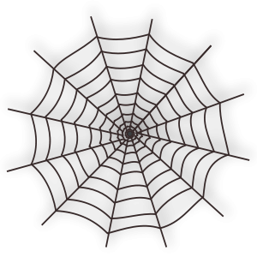
Standardization takes time
COMING SOON!
COMPREHENSIVE
STANDARD
DUE
2016
2036
2096

Slide 32
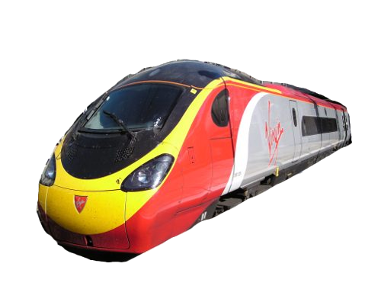
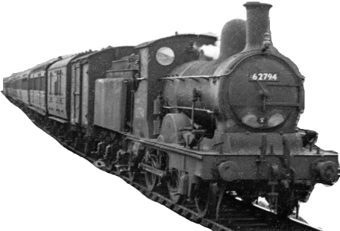
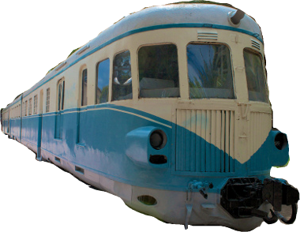
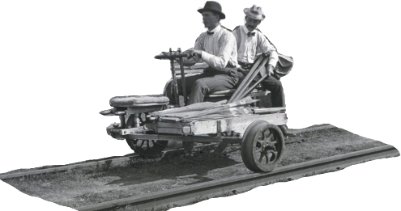
Modernization takes time
Existing systems cannot be updated all at once

Slide 33
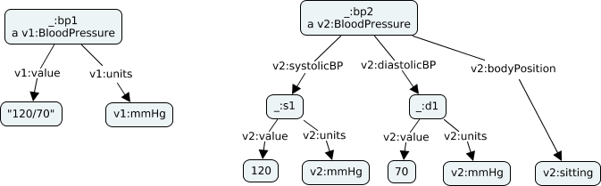
Diverse use cases
Different use cases need different data, granularity and representations
One standard does not fit all!

Slide 34
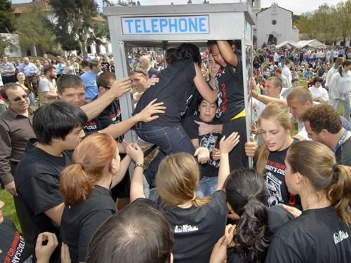
Cannot fit all use cases into one data model or vocabulary!

Slide 35
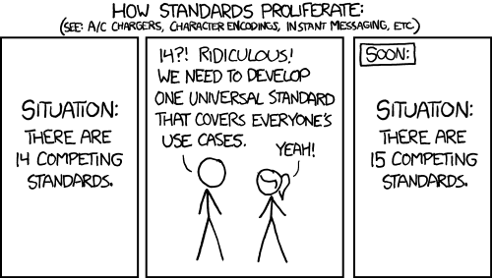
How Standards Proliferate
http://xkcd.com/927/
Used by permission

Slide 36

Standards evolve
Version n+1 improves on version n
NEW!
IMPROVED!
Standard

Slide 37
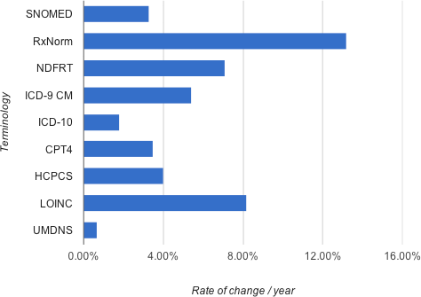
Healthcare terminologies rate of change
Slide credit: Rafael Richards (VA)

Slide 38
Translation is unavoidable!

Slide 39
A realistic strategy for semantic interoperability must address both
standards and translations.

Slide 40
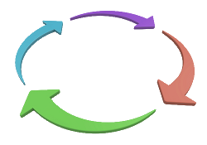

Yosemite Project Roadmap
Semantic
Interoperability
6. Collaborative
Standards
Convergence
7. Interoperability
Policies
5. RDF/OWL
Standards
Definitions
4. Crowd-Sourced
Translation
Rules
Standards
Translations
2. RDF Mappings
3. Translations
between models
& vocabularies
1. RDF as a Universal
Information
Representation
Notes:
To address both the standards and the translations prongs of interoperability strategy, the roadmap has two tracks.

Slide 41
Roadmap - 1
Semantic
Interoperability
Use RDF as a common semantic foundation
6. Collaborative
Standards
Convergence
7. Interoperability
Policies
5. RDF/OWL
Standards
Definitions
4. Crowd-Sourced
Translation
Rules
Standards
Translations
2. RDF Mappings
3. Translations
between models
& vocabularies
1. RDF as a Universal
Information
Representation
1. RDF as a Universal
Information
Representation

Slide 42
Roadmap - 2
Semantic
Interoperability
6. Collaborative
Standards
Convergence
7. Interoperability
Policies
5. RDF/OWL
Standards
Definitions
4. Crowd-Sourced
Translation
Rules
Standards
Translations
2. RDF Mappings
2. RDF Mappings
3. Translations
between models
& vocabularies
1. RDF as a Universal
Information
Representation

Slide 43
Roadmap - 3
Semantic
Interoperability
6. Collaborative
Standards
Convergence
7. Interoperability
Policies
5. RDF/OWL
Standards
Definitions
4. Crowd-Sourced
Translation
Rules
Standards
Translations
2. RDF Mappings
3. Translations
between models
& vocabularies
3. Translations
between models
& vocabularies
1. RDF as a Universal
Information
Representation

Slide 44
Roadmap - 4
Semantic
Interoperability
6. Collaborative
Standards
Convergence
7. Interoperability
Policies
5. RDF/OWL
Standards
Definitions
4. Crowd-Sourced
Translation
Rules
Standards
4. Crowd-Sourced
Translation
Rules
Translations
2. RDF Mappings
3. Translations
between models
& vocabularies
1. RDF as a Universal
Information
Representation

Slide 45
Roadmap - 5
Semantic
Interoperability
6. Collaborative
Standards
Convergence
7. Interoperability
Policies
5. RDF/OWL
Standards
Definitions
5. RDF/OWL
Standards
Definitions
4. Crowd-Sourced
Translation
Rules
Standards
Translations
2. RDF Mappings
3. Translations
between models
& vocabularies
1. RDF as a Universal
Information
Representation

Slide 46
Roadmap - 6
Semantic
Interoperability
6. Collaborative
Standards
Convergence
6. Collaborative
Standards
Convergence
7. Interoperability
Policies
5. RDF/OWL
Standards
Definitions
4. Crowd-Sourced
Translation
Rules
Standards
Translations
2. RDF Mappings
3. Translations
between models
& vocabularies
1. RDF as a Universal
Information
Representation

Slide 47
Roadmap - 7
Semantic
Interoperability
6. Collaborative
Standards
Convergence
7. Interoperability
Policies
7. Interoperability
Policies
5. RDF/OWL
Standards
Definitions
4. Crowd-Sourced
Translation
Rules
Standards
Translations
2. RDF Mappings
3. Translations
between models
& vocabularies
1. RDF as a Universal
Information
Representation

Slide 48
Yosemite Project Roadmap
Semantic
Interoperability
6. Collaborative
Standards
Convergence
7. Interoperability
Policies
5. RDF/OWL
Standards
Definitions
4. Crowd-Sourced
Translation
Rules
Standards
Translations
2. RDF Mappings
3. Translations
between models
& vocabularies
1. RDF as a Universal
Information
Representation
Notes:
To address both the standards and the translations prongs of interoperability strategy, the roadmap has two tracks.

Slide 49
ONC Roadmap

Slide 50

ONC Interoperability Roadmap Draft v1.0
166 pages
Comments due 3-Apr-2015
http://www.healthit.gov/policy-researchers-implementers/interoperability

Slide 51
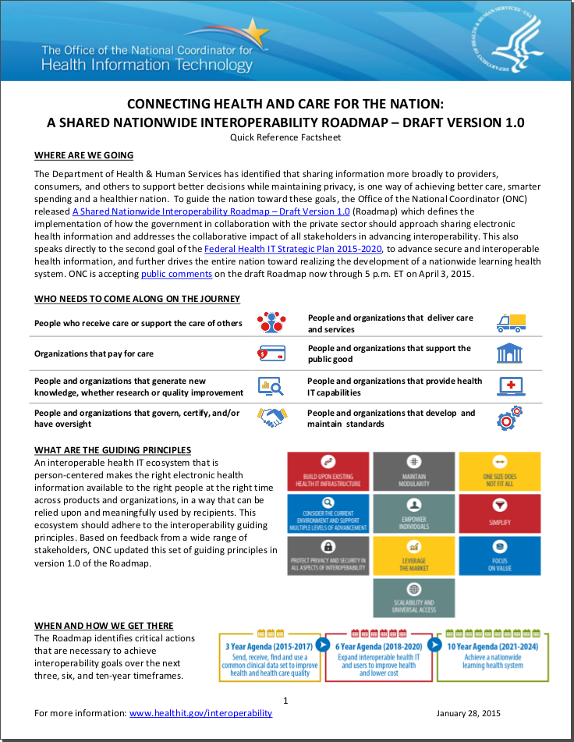
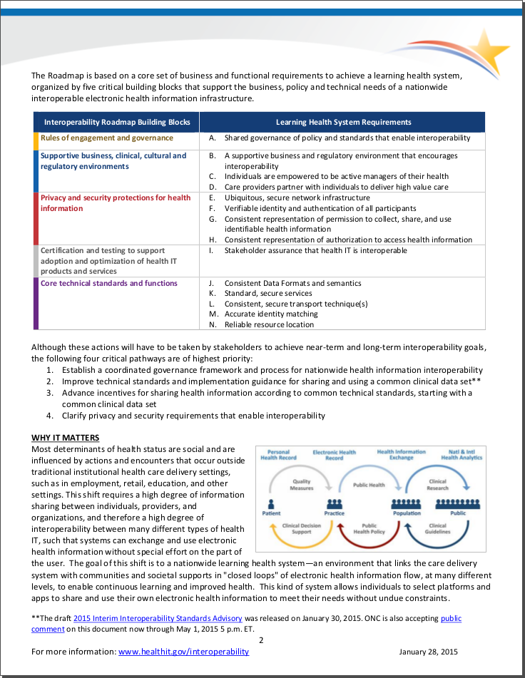
ONC Roadmap Quick Reference

Slide 52
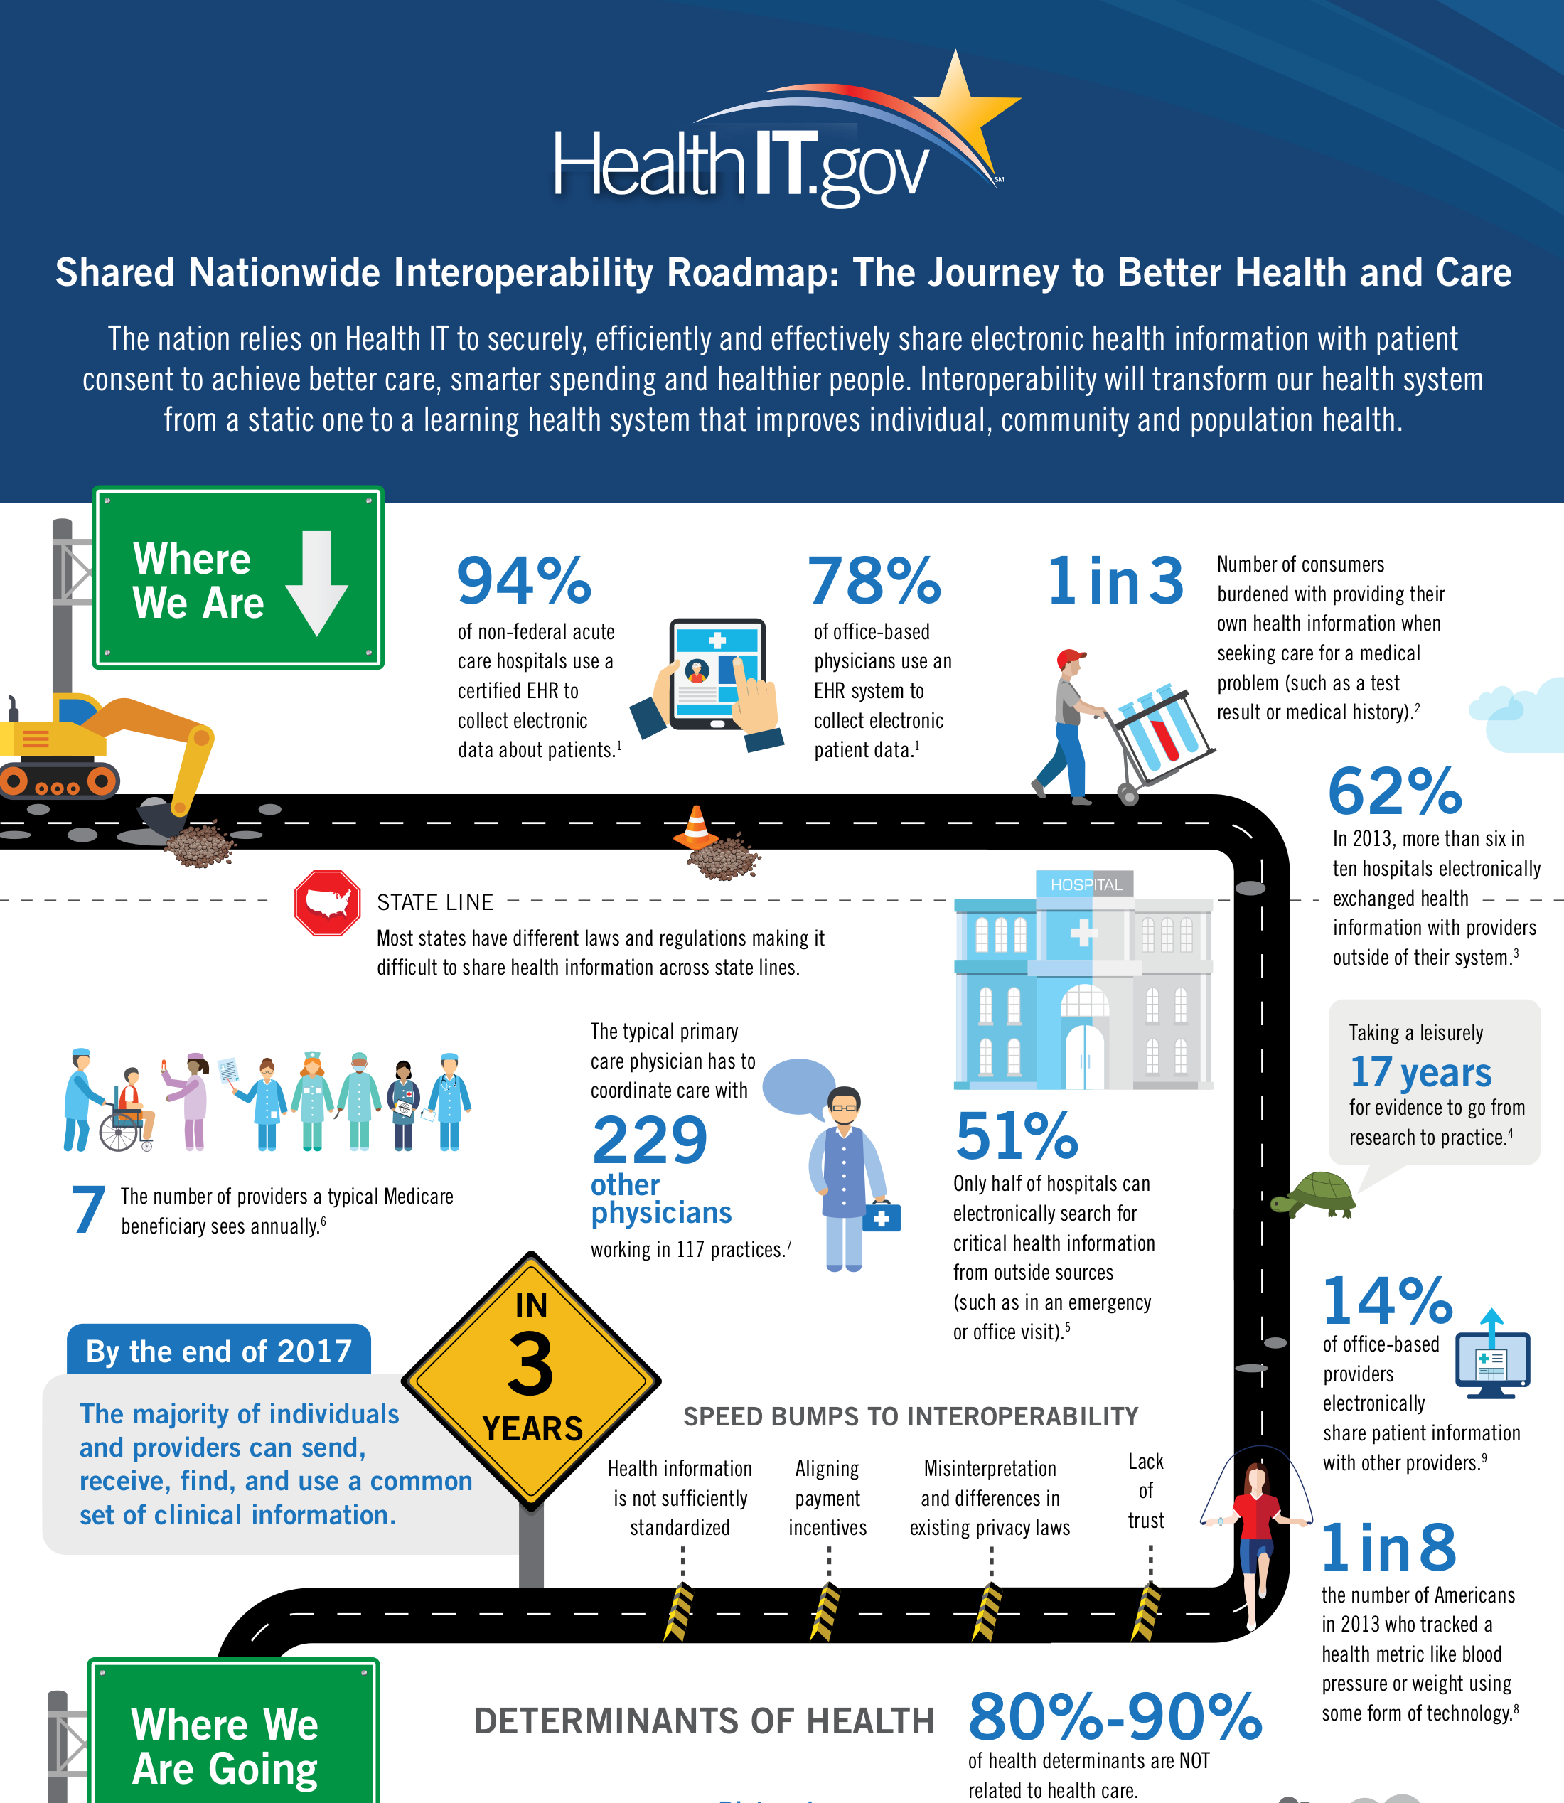
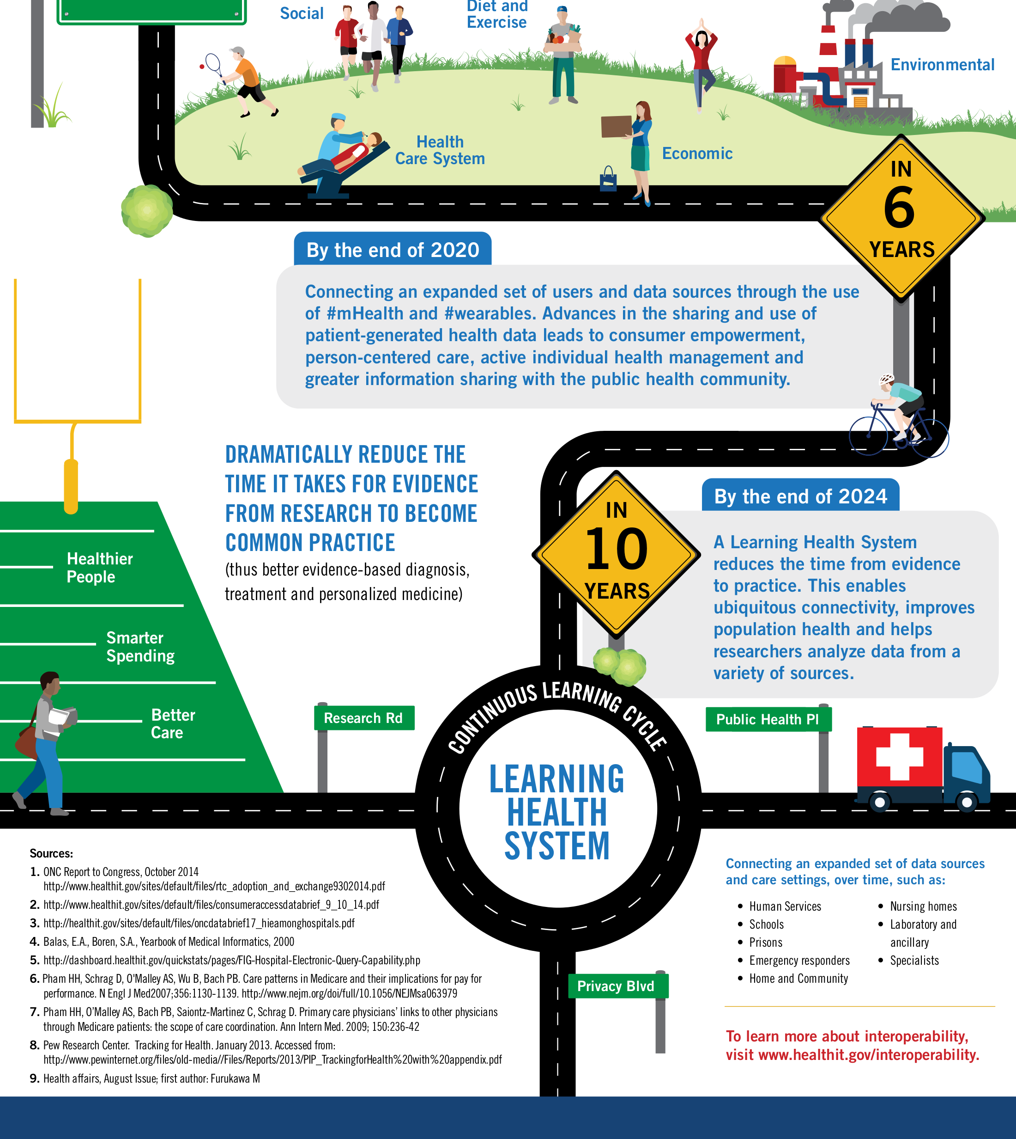
ONC Roadmap Infographic
. . .
. . .

Slide 53
What's in the ONC roadmap?
Health IT vision: "learning health system"
Interoperability goals: 3, 6, 10 years
Problem description
  Components, stakeholders and issues
Solution guidance, involving:
  Governance
  Standards
  Policies

Slide 54
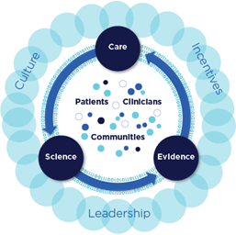
Institute of Medicine:
Learning Health System
See http://www.iom.edu/Activities/Quality/VSRT.aspx

Slide 55
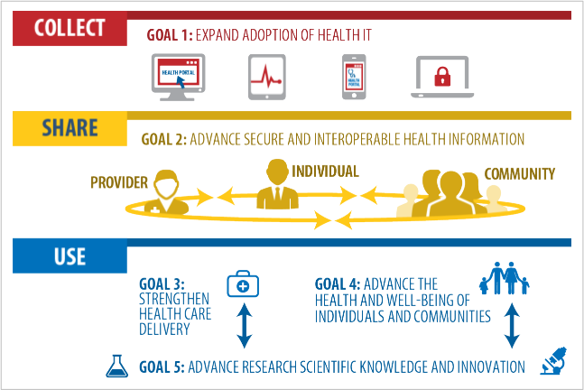
ONC strategic goals
ONC Roadmap p16

Slide 56
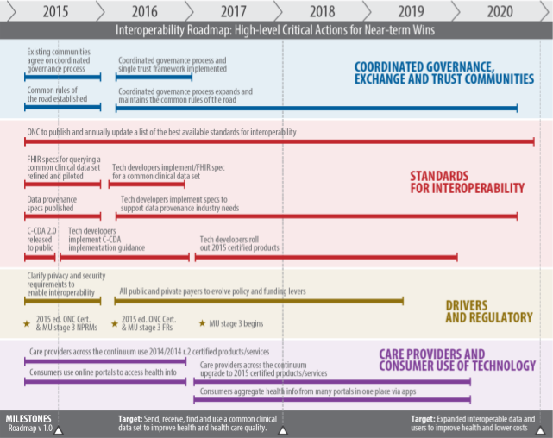
ONC timeline
ONC Roadmap p15

Slide 57
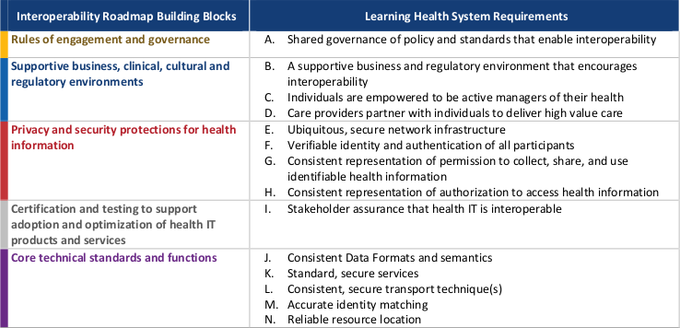
ONC building blocks
10 pages
15 pages
22 pages
3 pages
25 pages
ONC Quick Reference p2

Slide 58
ONC building blocks
10 pages
15 pages
22 pages
3 pages
25 pages
ONC Quick Reference p2

Slide 59
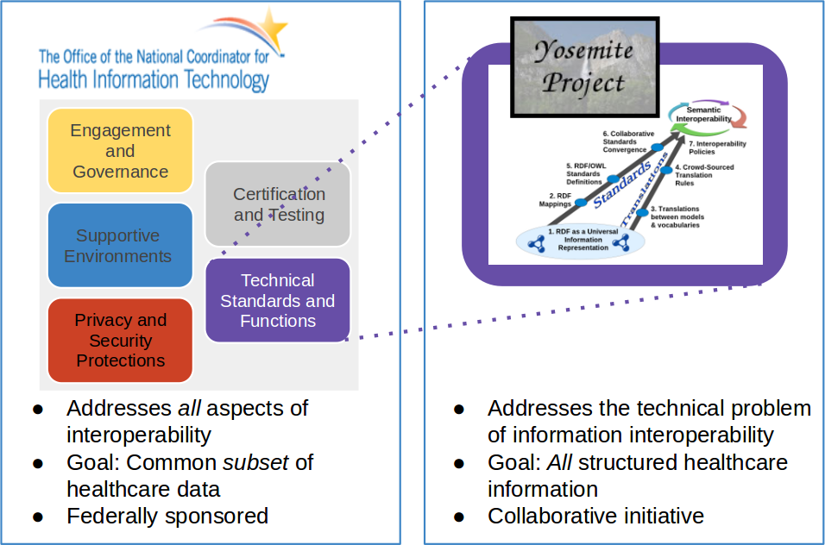
Comparison of roadmaps
Addresses all aspects of interoperability
Goal: Interop of a common subset of healthcare data
Federally sponsored
Addresses the technical problem of information interoperability
Goal: Interop of all structured healthcare information
Collaborative initiative

Slide 60

Kudos:
General
Undertaking this roadmap!
Addressing all stakeholders
Joint public & private governance strategy
Attention to standards
Policy incentives
Removing barriers to interoperability

Slide 61

Suggestion:
Clarify "Rules of the Road"
Not clear what this phrase means
Policies? Governance process?
  Policies (incentives & remove barriers)

Slide 62
Kudo:
Need for interoperability incentives
Key barrier: "fee-for-service" payment models -- p38
  "Current policies and financial incentives often prevent . . . exchange, even when it is technically feasible." -- p37
  "[We] need to migrate policy and funding levers to create the business imperative and clinical demand for interoperability" -- p37
  "Rules that govern how health and care are paid for must create a context in which interoperability is not just a way to improve care, but is a good business decision." -- p37
SUGGESTION:
Stronger incentive policies (carrot/stick)

Slide 63

Kudo:
Empowering the individual
Increasingly important:
  Mobile population – receiving
  care from multiple providers
  Rising costs
  Patient-generated health data
SUGGESTION:
Data must be both human and
machine understandable
  Encourages innovation

Slide 64
Kudo:
Access to Personal Health Information
"No policy, business, operational, or technical barriers that are not required by law should be built to prevent information from appropriately flowing across geographic, health IT developer and organizational boundaries in support of patient care." -- p31
SUGGESTION:
Should apply to all aspects of healthcare (research, quality measurement, etc.)

Slide 65

Kudo:
Open Exchange
"There should be neutrality in the exchange of personal health information. [. . .] For instance, a health IT developer . . . shall not prevent a user from using health information exchange applications developed by competitors"
-- p33

Slide 66

Suggestion:
Encourage free and open interoperability standards
IP
Barriers
No royalties
No licensing barriers

Slide 67
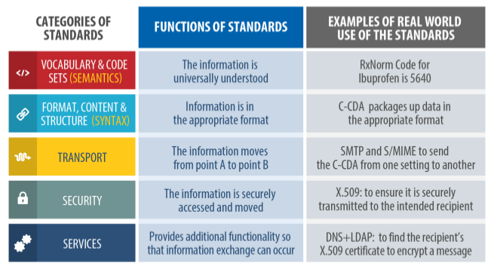
ONC categories of standards
ONC Roadmap p78

Slide 68
Difference: ONC focus on a
"common clinical data set"
"This Roadmap focuses on decisions, actions and actors required to establish the best minimum level of interoperability across the health IT ecosystem" -- p18
Forces all users into
one box

Slide 69
Misconception:
How to achieve interoperability
"[It] is unlikely that a single data format . . . will support all of the needs of a learning health system . . . ." -- p82
That is exactly what RDF does!
(except that RDF is not a data format)
  Universal information representation
  Reason for the Yosemite Manifesto
  Yosemite Project roadmap shows how

Slide 70
Suggestion:
More focus on data
ONC roadmap mentions "Interoperability of processes and workflows"
Data interoperability is far more important

Slide 71


All Things
APIs
Services
Workflows
Applications come and go,
but data lives forever

Slide 72


Kudo: RESTful interfaces
More than just HTTP!
Uniform interface / API
Data-centric
("Resource-centric")
Obviates the need
for many specialized
protocols
UNIVERSITY OF CALIFORNIA,
IRVINE
Architectural Styles and the Design of Network-based Software Architectures
DISSERTATION
submitted in partial satisfaction of the requirements for the degree of
DOCTOR OF PHILOSOPHY
in Information and Computer Science
by
Roy Thomas Fielding
Dissertation Committee:
Professor Richard N. Taylor, Chair
Professor Mark S. Ackerman
Professor David S. Rosenblum
2000
SUGGESTION: More emphasis

Slide 73
Suggestion:
Stable URIs for concepts
Use of Linked Data principles
Stable URIs for all concepts
Every concept URI should link to its authoritative definition
  Both machine and human oriented
  Free and open – no IP barriers
YosemiteManifesto.org

Slide 74
Suggestions:
General
Support the Yosemite Project
  RDF as a common semantic layer
Stronger policies:
  Incentives for interoperability
  Free and open standards

Slide 75
Report Card
Scope and Vision
Problem Insight
Focus
Articulation
Feasibility
Execution
A+
A
B
B+
A-
?

Slide 76
Questions?

Slide 77
Comparison of roadmaps
Addresses all aspects of interoperability
Goal: Interop of a common subset of healthcare data
Federally sponsored
Addresses the technical problem of information interoperability
Goal: Interop of all structured healthcare information
Collaborative initiative

Slide 78
BACKUP SLIDES

Slide 79
http://YosemiteProject.org/
A Roadmap for Healthcare Information Interoperability
Semantic
Interoperability
6. Collaborative
Standards
Convergence
7. Interoperability
Policies
5. RDF/OWL
Standards
Definitions
4. Crowd-Sourced
Translation
Rules
Standards
Translations
2. RDF Mappings
3. Translations
between models
& vocabularies
1. RDF as a Universal
Information
Representation
Notes:
To address both the standards and the translations prongs of interoperability strategy, the roadmap has two tracks.

Slide 80
Yosemite Project Roadmap
Semantic
Interoperability
6. Collaborative
Standards
Convergence
7. Interoperability
Policies
5. RDF/OWL
Standards
Definitions
4. Crowd-Sourced
Translation
Rules
Standards
Translations
2. RDF Mappings
3. Translations
between models
& vocabularies
1. RDF as a Universal
Information
Representation
Notes:
To address both the standards and the translations prongs of interoperability strategy, the roadmap has two tracks.

Slide 81
Roadmap - 1
Semantic
Interoperability
Use RDF as a common semantic foundation
6. Collaborative
Standards
Convergence
7. Interoperability
Policies
5. RDF/OWL
Standards
Definitions
4. Crowd-Sourced
Translation
Rules
Standards
Translations
2. RDF Mappings
3. Translations
between models
& vocabularies
1. RDF as a Universal
Information
Representation
1. RDF as a Universal
Information
Representation

Slide 82
Roadmap - 2
Semantic
Interoperability
For common healthcare information representations*, define an RDF mapping to/from each format, data model and vocabulary – "lift" and "drop".
6. Collaborative
Standards
Convergence
7. Interoperability
Policies
5. RDF/OWL
Standards
Definitions
4. Crowd-Sourced
Translation
Rules
Standards
*Both standard and proprietary
Translations
2. RDF Mappings
2. RDF Mappings
3. Translations
between models
& vocabularies
1. RDF as a Universal
Information
Representation

Slide 83
Roadmap - 3
Define translation rules for instance data that is expressed in RDF representations
Semantic
Interoperability
6. Collaborative
Standards
Convergence
7. Interoperability
Policies
5. RDF/OWL
Standards
Definitions
4. Crowd-Sourced
Translation
Rules
Standards
Translations
2. RDF Mappings
3. Translations
between models
& vocabularies
3. Translations
between models
& vocabularies
1. RDF as a Universal
Information
Representation

Slide 84
Roadmap - 4
Semantic
Interoperability
Create a hub for crowd-sourcing translation rules
6. Collaborative
Standards
Convergence
7. Interoperability
Policies
5. RDF/OWL
Standards
Definitions
4. Crowd-Sourced
Translation
Rules
Standards
4. Crowd-Sourced
Translation
Rules
Translations
2. RDF Mappings
3. Translations
between models
& vocabularies
1. RDF as a Universal
Information
Representation

Slide 85
Roadmap - 5
Semantic
Interoperability
Create RDF / OWL definitions of the data models and vocabularies defined by healthcare standards
6. Collaborative
Standards
Convergence
7. Interoperability
Policies
5. RDF/OWL
Standards
Definitions
5. RDF/OWL
Standards
Definitions
4. Crowd-Sourced
Translation
Rules
Standards
Translations
2. RDF Mappings
3. Translations
between models
& vocabularies
1. RDF as a Universal
Information
Representation

Slide 86
Roadmap - 6
Semantic
Interoperability
6. Collaborative
Standards
Convergence
6. Collaborative
Standards
Convergence
7. Interoperability
Policies
5. RDF/OWL
Standards
Definitions
4. Crowd-Sourced
Translation
Rules
Standards
Create a collaborative standards hub for RDF/OWL standards definitions, to facilitate standards convergence
Translations
2. RDF Mappings
3. Translations
between models
& vocabularies
1. RDF as a Universal
Information
Representation

Slide 87
Roadmap - 7
Semantic
Interoperability
Adopt policy incentives for healthcare providers to achieve semantic interoperability.
6. Collaborative
Standards
Convergence
7. Interoperability
Policies
7. Interoperability
Policies
5. RDF/OWL
Standards
Definitions
4. Crowd-Sourced
Translation
Rules
Standards
Translations
2. RDF Mappings
3. Translations
between models
& vocabularies
1. RDF as a Universal
Information
Representation

Slide 88
Roadmap - 7
Semantic
Interoperability
(a) Adopt free and open interoperability standards.
6. Collaborative
Standards
Convergence
7. Interoperability
Policies
7. Interoperability
Policies
5. RDF/OWL
Standards
Definitions
4. Crowd-Sourced
Translation
Rules
Why?
Eliminate IP barriers to interoperability.
Standards
Translations
2. RDF Mappings
3. Translations
between models
& vocabularies
1. RDF as a Universal
Information
Representation

Slide 89
Roadmap - 7
Semantic
Interoperability
(b) Adopt policy incentives for healthcare providers to achieve semantic interoperability.
6. Collaborative
Standards
Convergence
7. Interoperability
Policies
7. Interoperability
Policies
5. RDF/OWL
Standards
Definitions
4. Crowd-Sourced
Translation
Rules
Why?
A healthcare provider has no natural business incentive to make its data interoperable with competitors.
Standards
Translations
2. RDF Mappings
3. Translations
between models
& vocabularies
1. RDF as a Universal
Information
Representation

Slide 90
Yosemite Project Roadmap
Semantic
Interoperability
6. Collaborative
Standards
Convergence
7. Interoperability
Policies
5. RDF/OWL
Standards
Definitions
4. Crowd-Sourced
Translation
Rules
Standards
Translations
2. RDF Mappings
3. Translations
between models
& vocabularies
1. RDF as a Universal
Information
Representation
Notes:
To address both the standards and the translations prongs of interoperability strategy, the roadmap has two tracks.

